Slide 1
2021 Incoming class Welcome to tHE BEST mstp in the galaxy

Slide 2
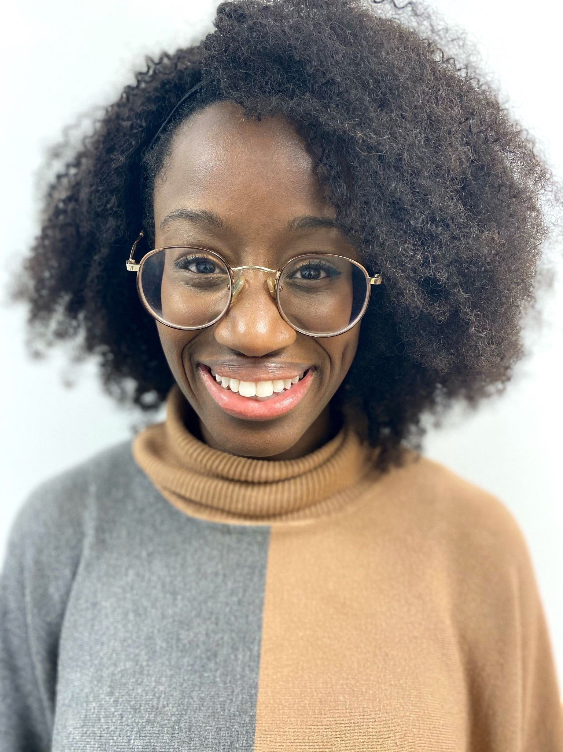
Josetta Adams
Previous institutions: City College of New York, Tufts University
Grad Group: IGG
Hometown: Brooklyn, NY
Fun fact: I used to be obsessed with the zombie apocalypse... and then I watched walking dead

Slide 3
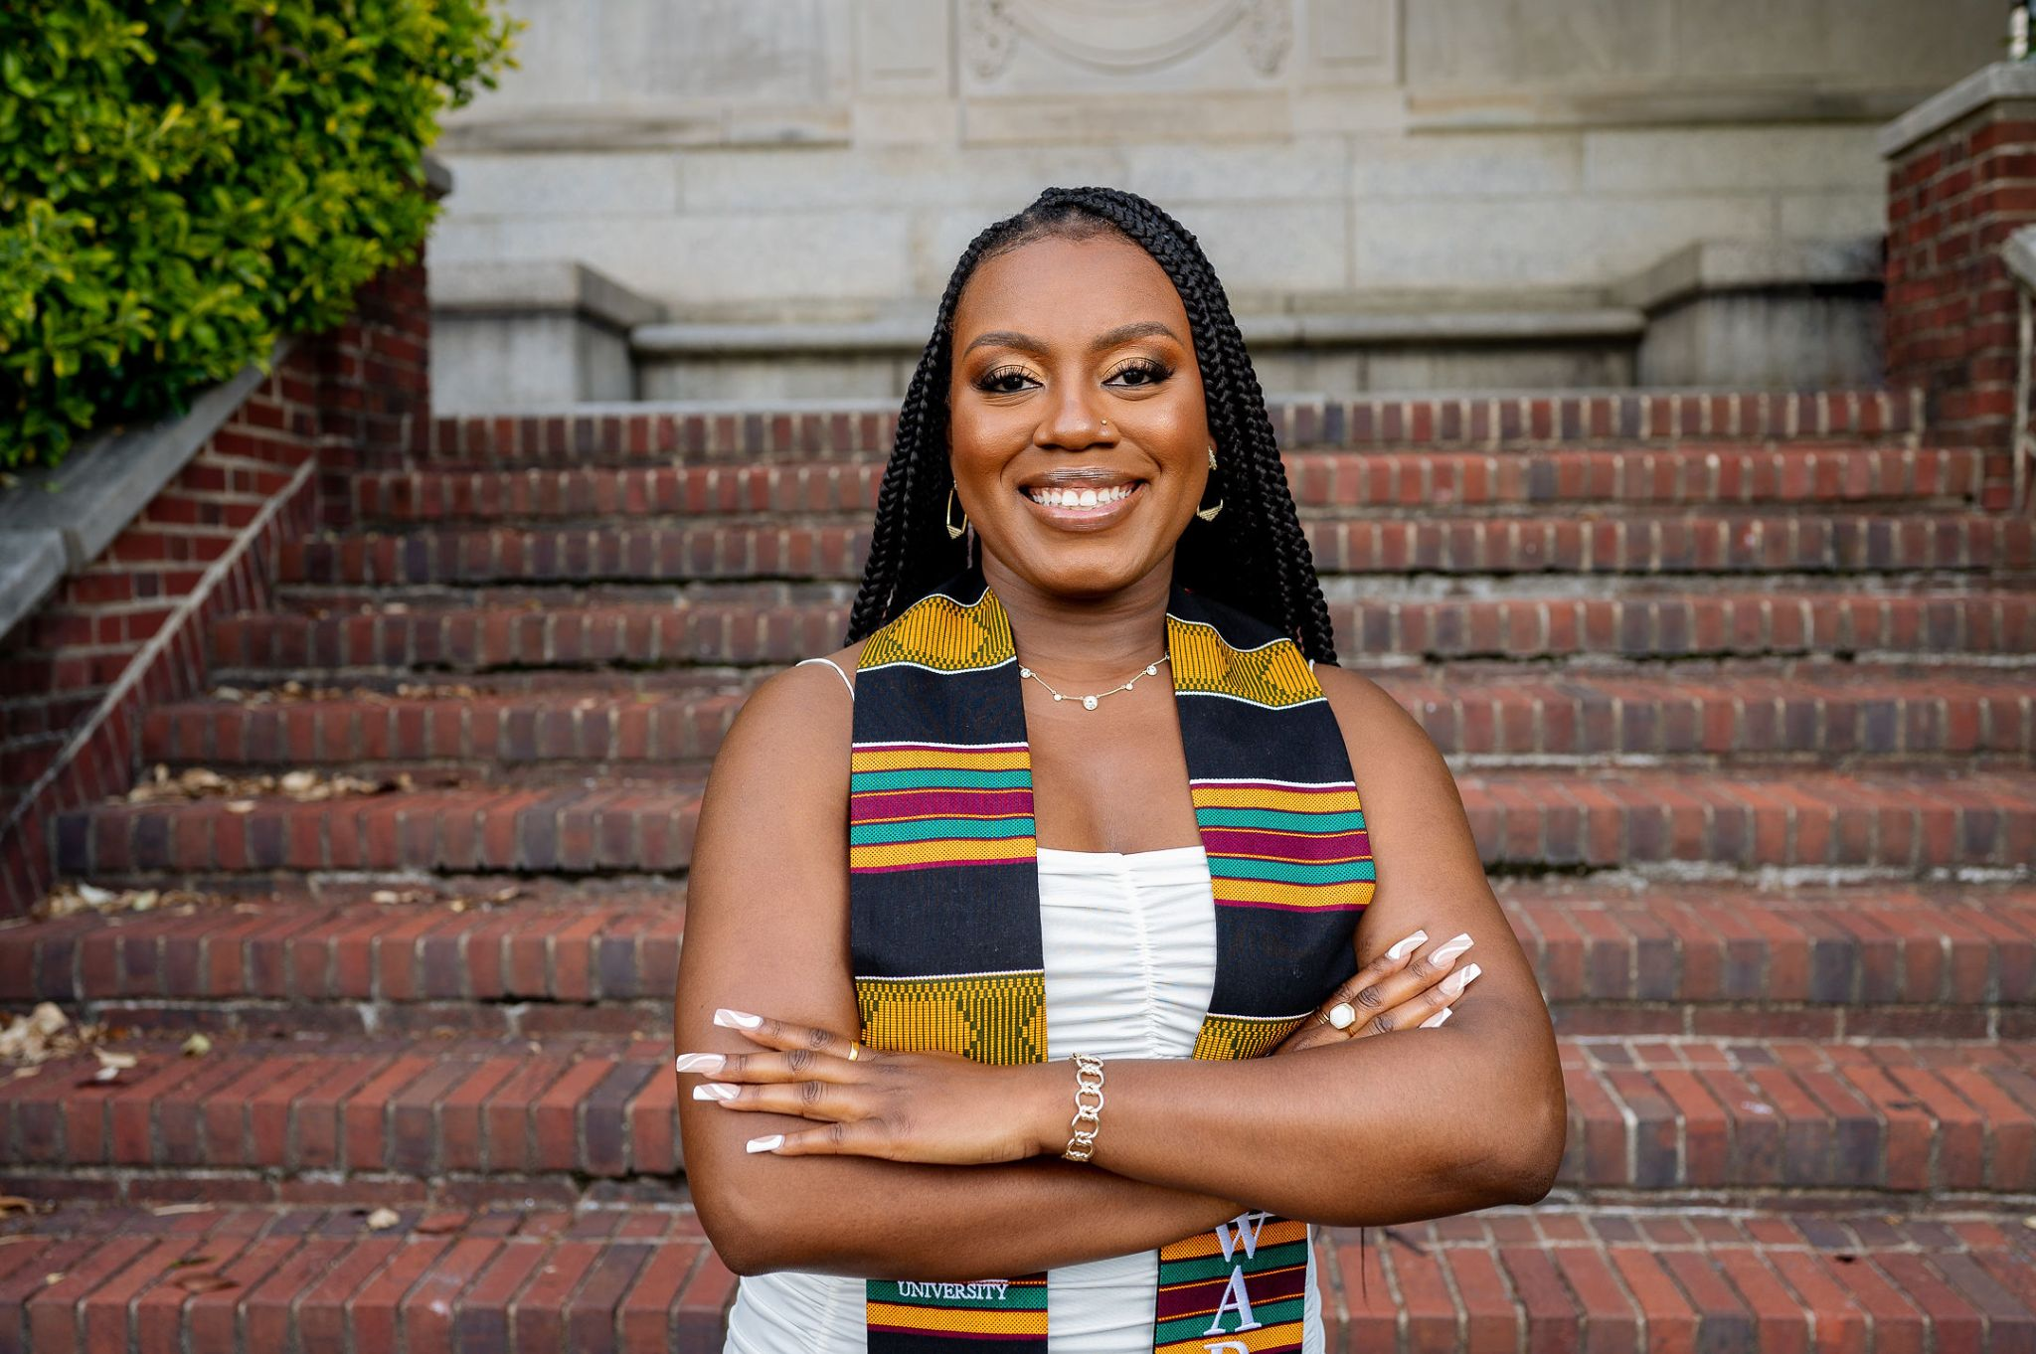
Alexandria Adigun
Previous institutions: Howard University
Grad Group: CAMB
Hometown: Houston, TX
Fun fact: I have performed in the Macy's Thanksgiving day parade!

Slide 4
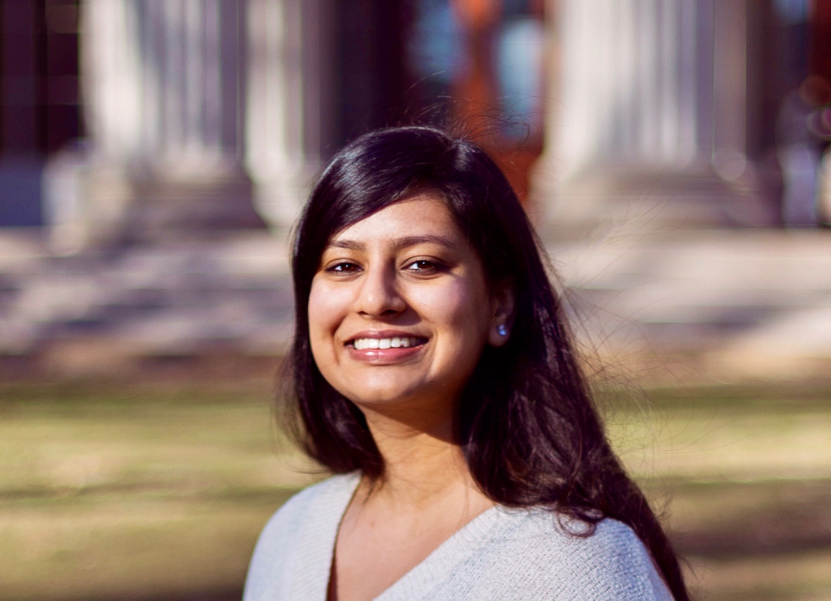
Muskaan Aggarwal
Previous institutions: MIT, Boston Children's Hospital/Ragon Institute
Grad Group: CAMB
Hometown: Folsom, CA
Fun fact: This summer, I went hiking on Europe's largest glacier, Vatnajökull!

Slide 5
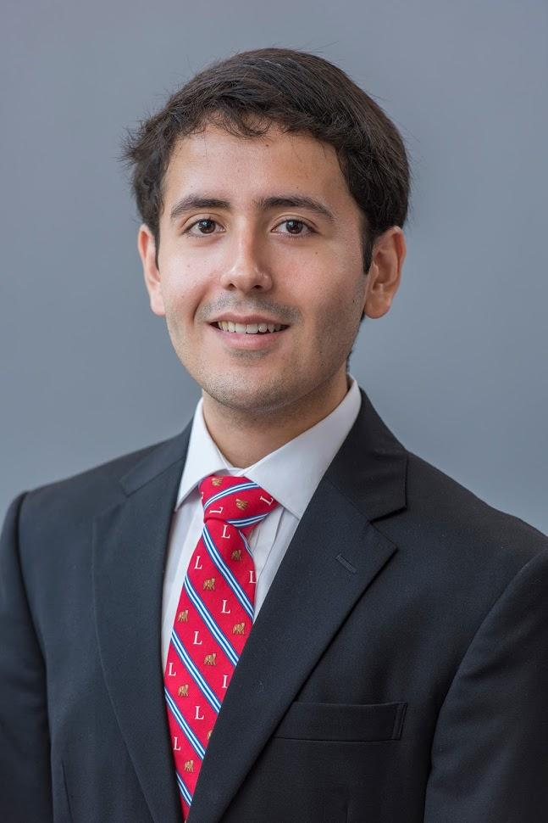
Orlando Arevalo
Previous institutions: Massachusetts Institute of Technology, Rubius Therapeutics
Grad Group: CAMB
Hometown: Silver Spring, MD
Fun fact: I like to brew kombucha at home to save money and because it's delicious!

Slide 6
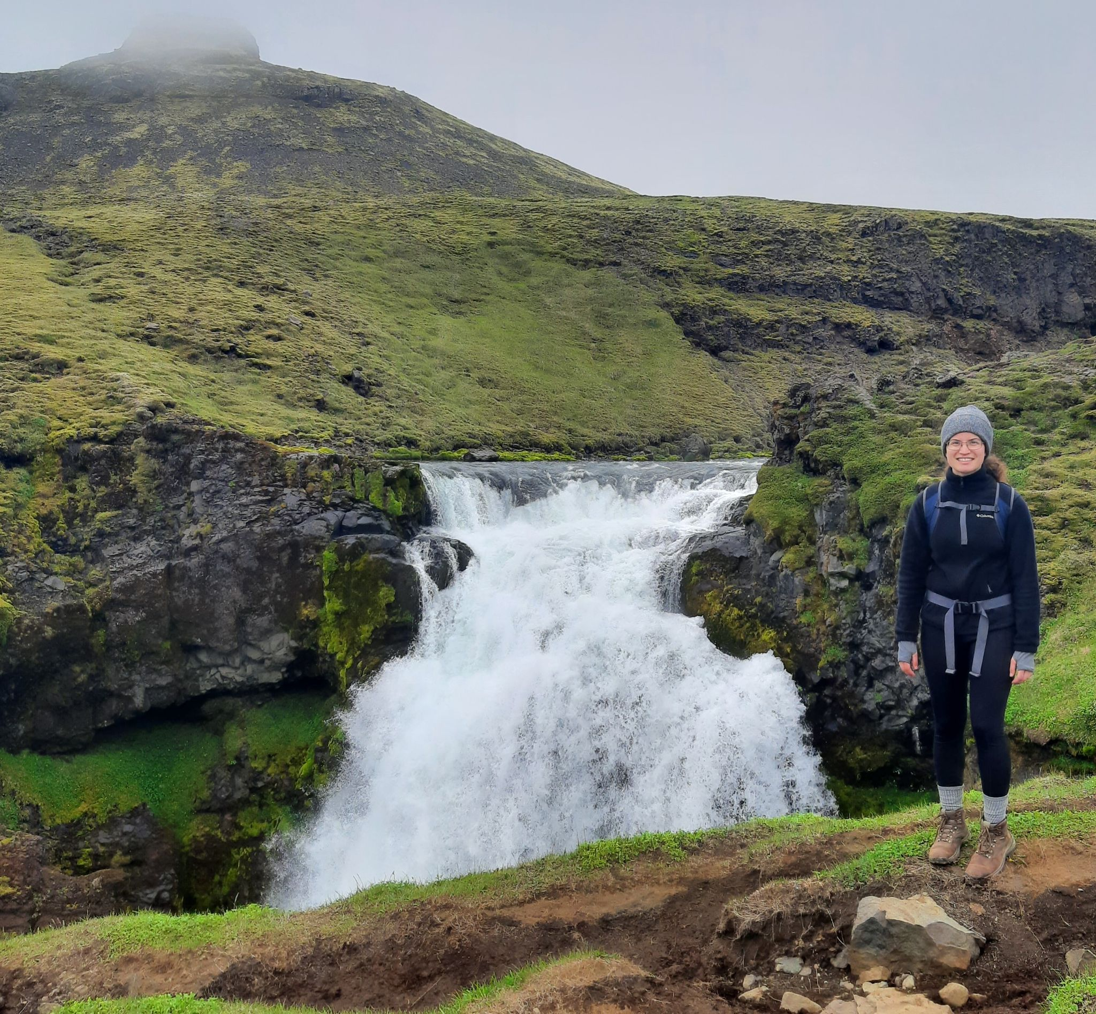
Katherine Dorfman
Previous institutions: Brandeis University, MGH
Grad Group: Neuroscience
Hometown: Boston
Fun fact: This summer I went to Iceland!

Slide 7
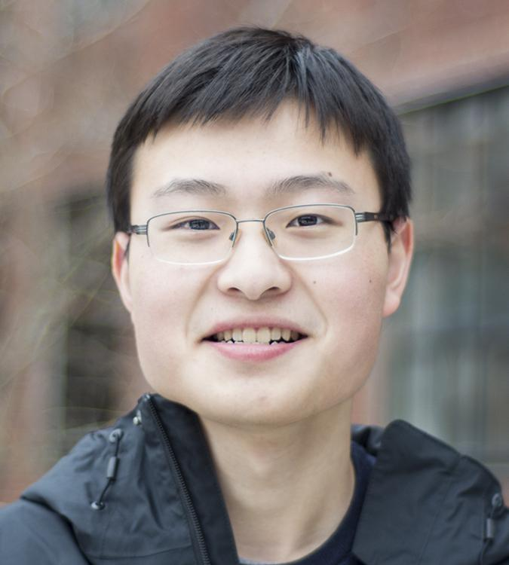
William Gao
Previous institutions: Harvard University, Karolinska Institute
Grad Group: GCB
Hometown: Boston, MA
Fun fact: I enjoy birdwatching.

Slide 8
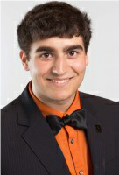
Sam Garfinkle
Previous institutions: Princeton, D.E. Shaw Research
Grad Group: BMB
Hometown: Rochester Hills, Michigan
Fun fact: I could legally drink at my own Bar Mitzvah.

Slide 9
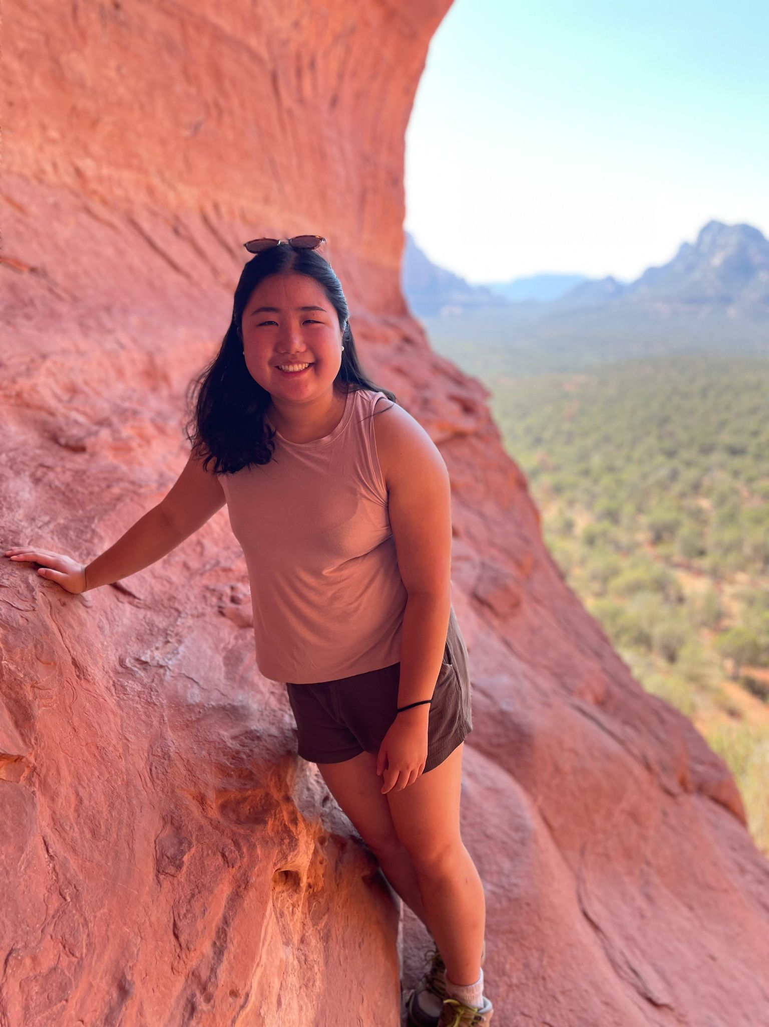
Angela Gong
Previous institutions: Yale College
Grad Group: Chemistry
Hometown: Lexington, MA
Fun fact: My family has a pet hedgehog and we named her Rosie, after Rosalind Franklin!

Slide 10
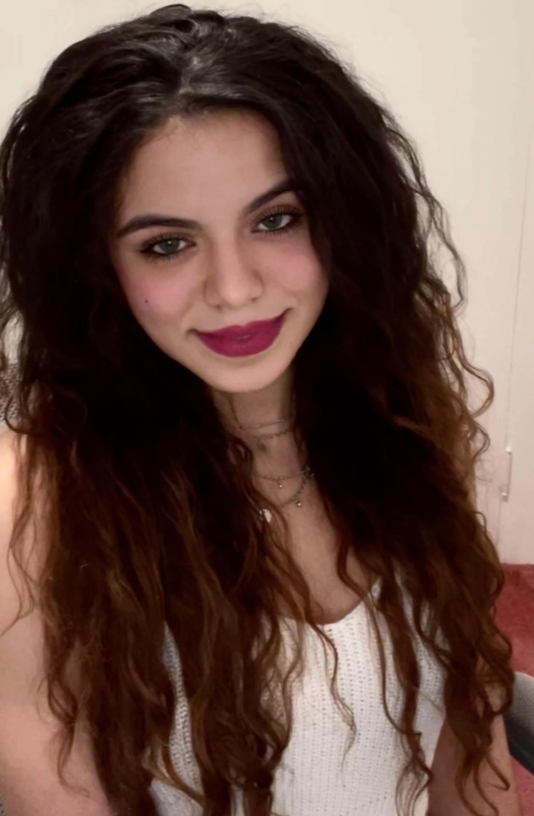
Luiselys Hernandez
Previous institutions: Drexel University, Temple's Lewis Katz School of Medicine
Grad Group: Neuroscience Graduate Group
Hometown: Philadelphia
Fun fact: I love to draw!

Slide 11
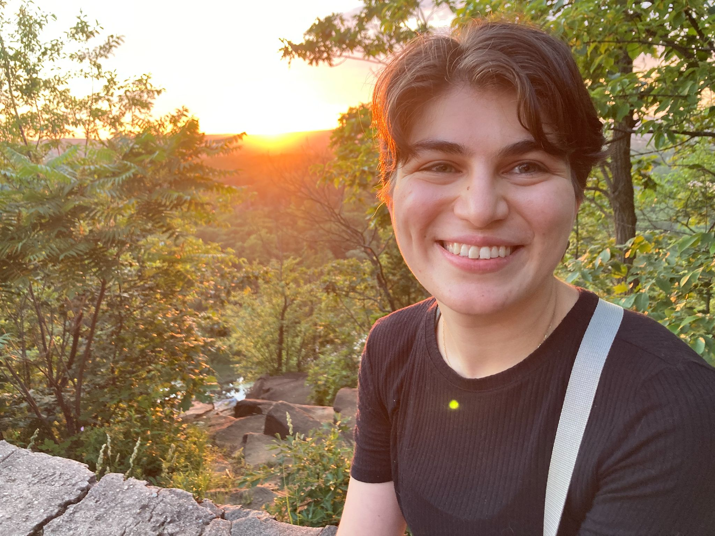
Eren Kafadar
Previous institutions: Yale University
Grad Group: Neuroscience
Hometown: Istanbul, Turkey
Fun fact: Once I won a Halloween costume contest dressed up as Madonna from the 'Like a Virgin' album cover, but only older Millennials and Gen Xers actually recognized who I was (the contest was administered by them too :) )

Slide 12
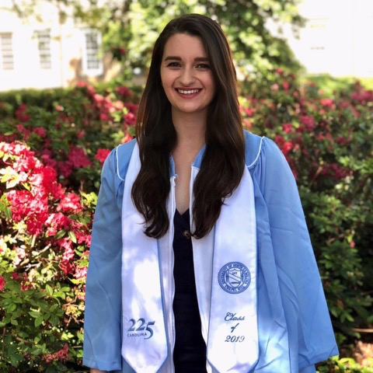
Sanam Kavari
Previous institutions: UNC-Chapel Hill, Broad Institute
Grad Group: CAMB
Hometown: Hillsborough, NC
Fun fact: I'm learning to play the mandolin

Slide 13
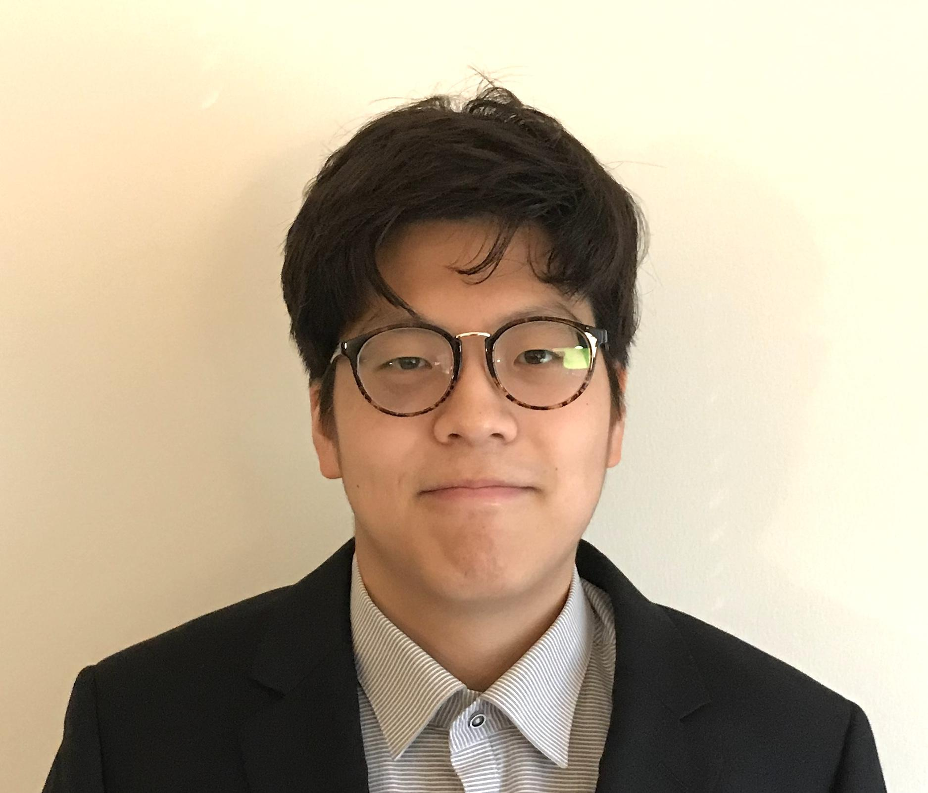
Samuel Kim
Previous institutions: Penn
Grad Group: Immunology Graduate Group
Hometown: Ilsan, South Korea (grew up in Maryland/DC)
Fun fact: I’m raising a corgi

Slide 14
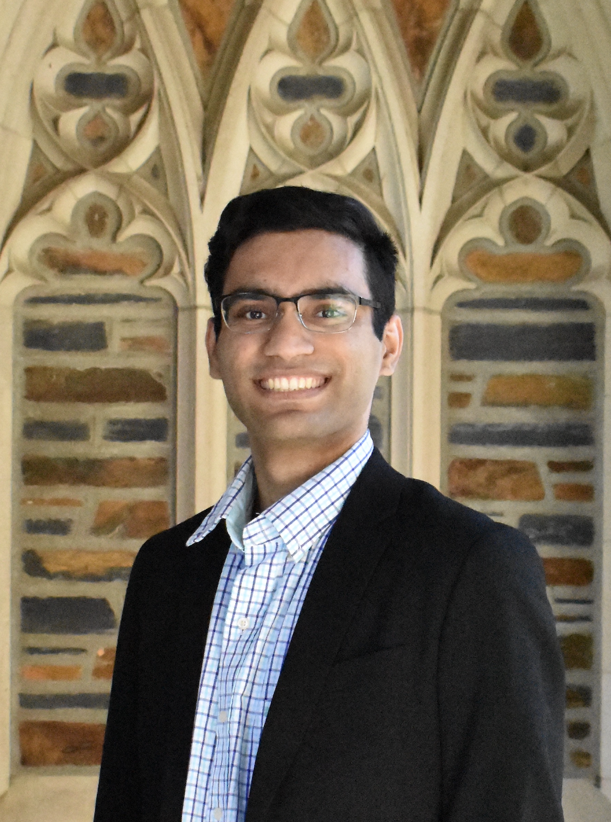
Rohin Maganti
Previous institutions: Duke University
Grad Group: Pharmacology
Hometown: Dallas
Fun fact: I have a twin brother who is also at Penn

Slide 15
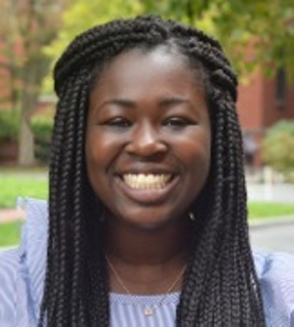
Mattia Mah'moud
Previous institutions: Harvard College, University of Cambridge
Grad Group: GGEB
Hometown: Raleigh, NC
Fun fact: I swam with sharks in Hawaii five years ago.

Slide 16
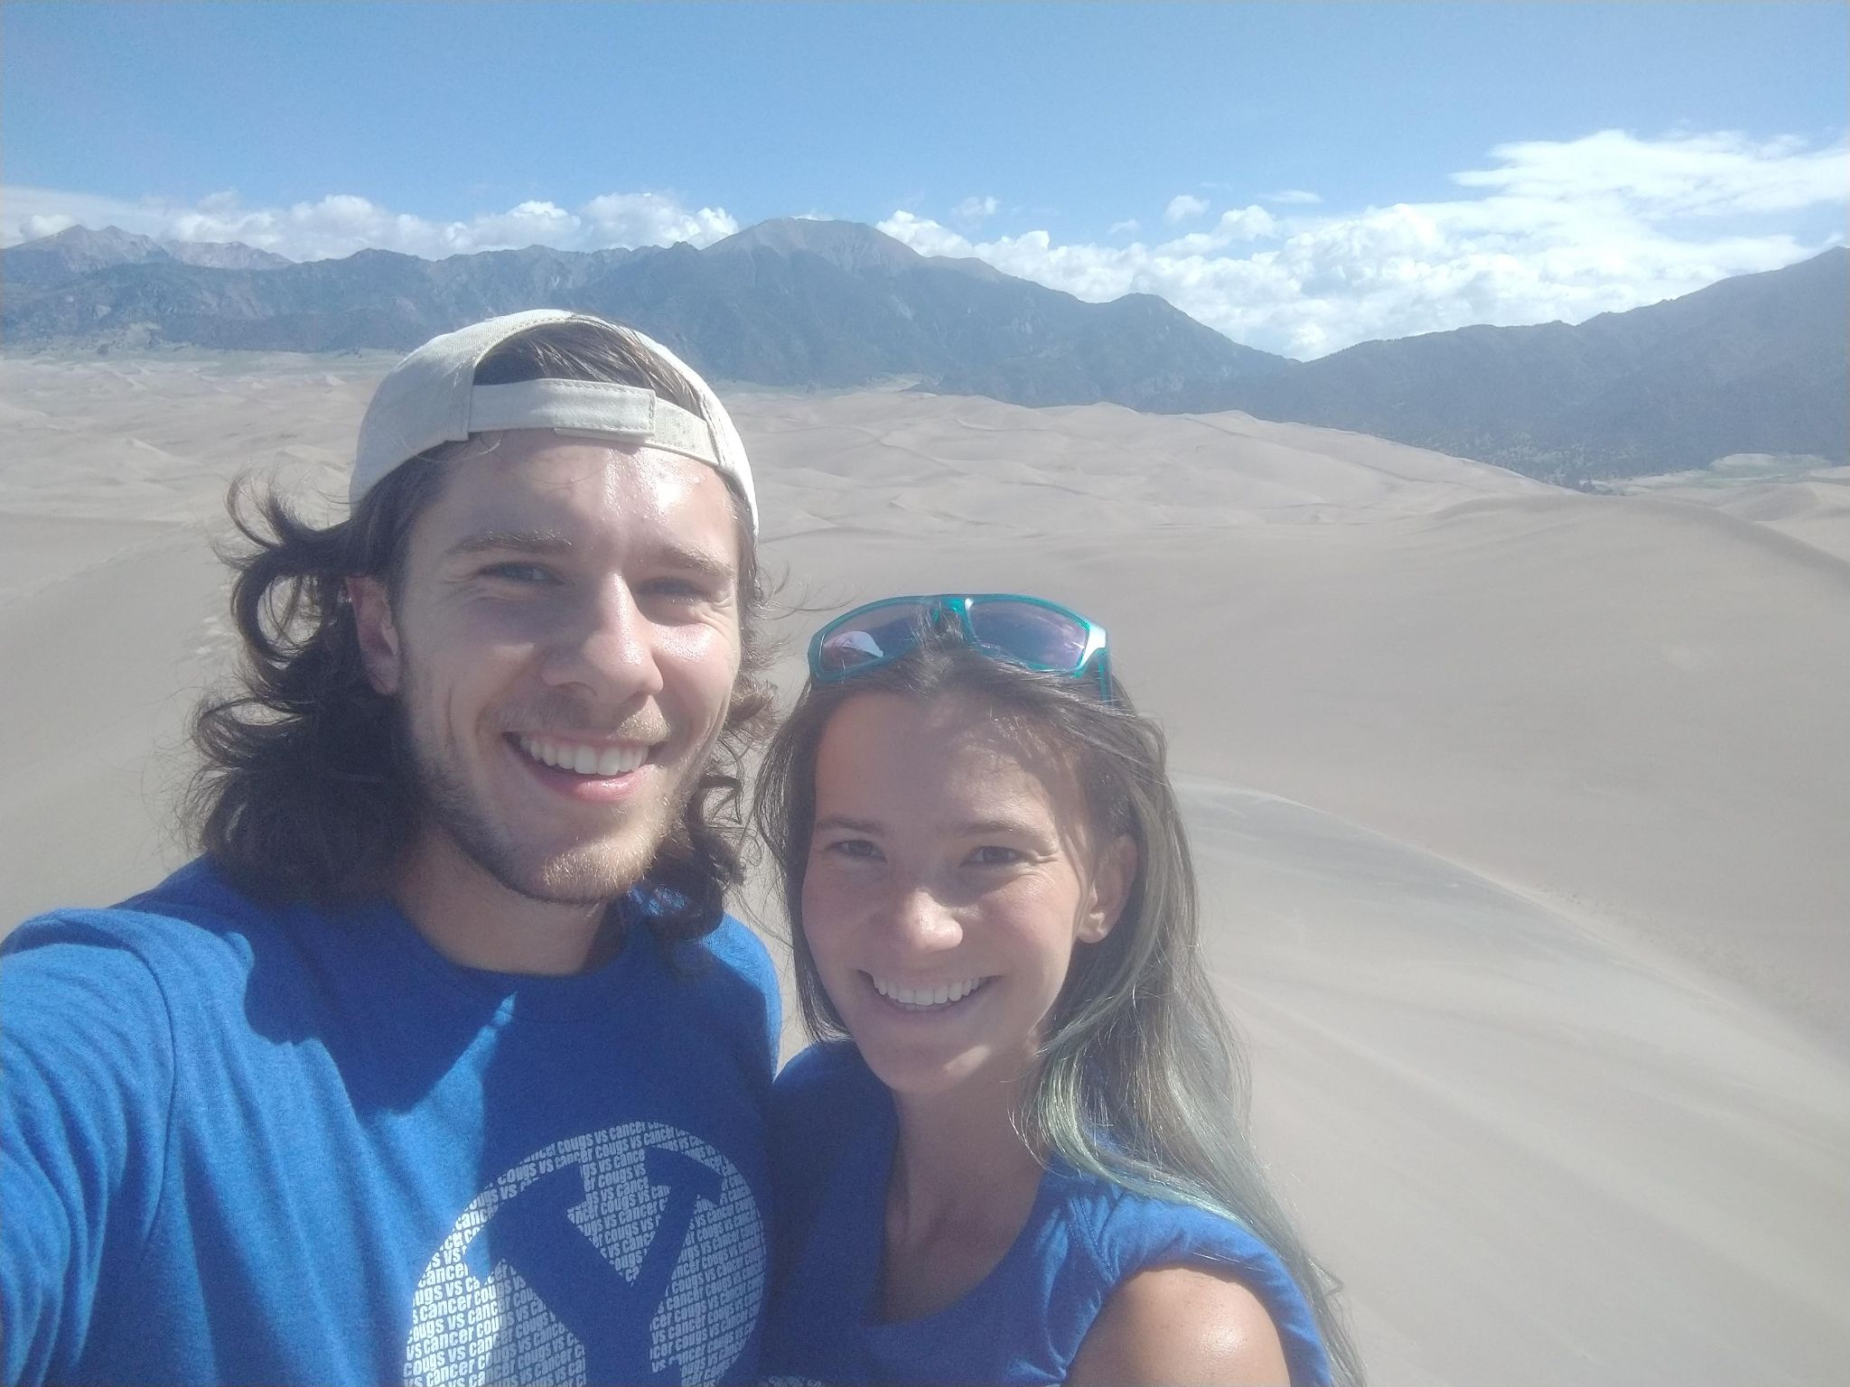
Andrew Nelson
Previous institutions: Brigham Young University (BYU)
Grad Group: Neuroscience
Hometown: Houston, TX
Fun fact: I love trying new recipes and cooking meals for people. My secret dream is to own a restaurant someday.

Slide 17
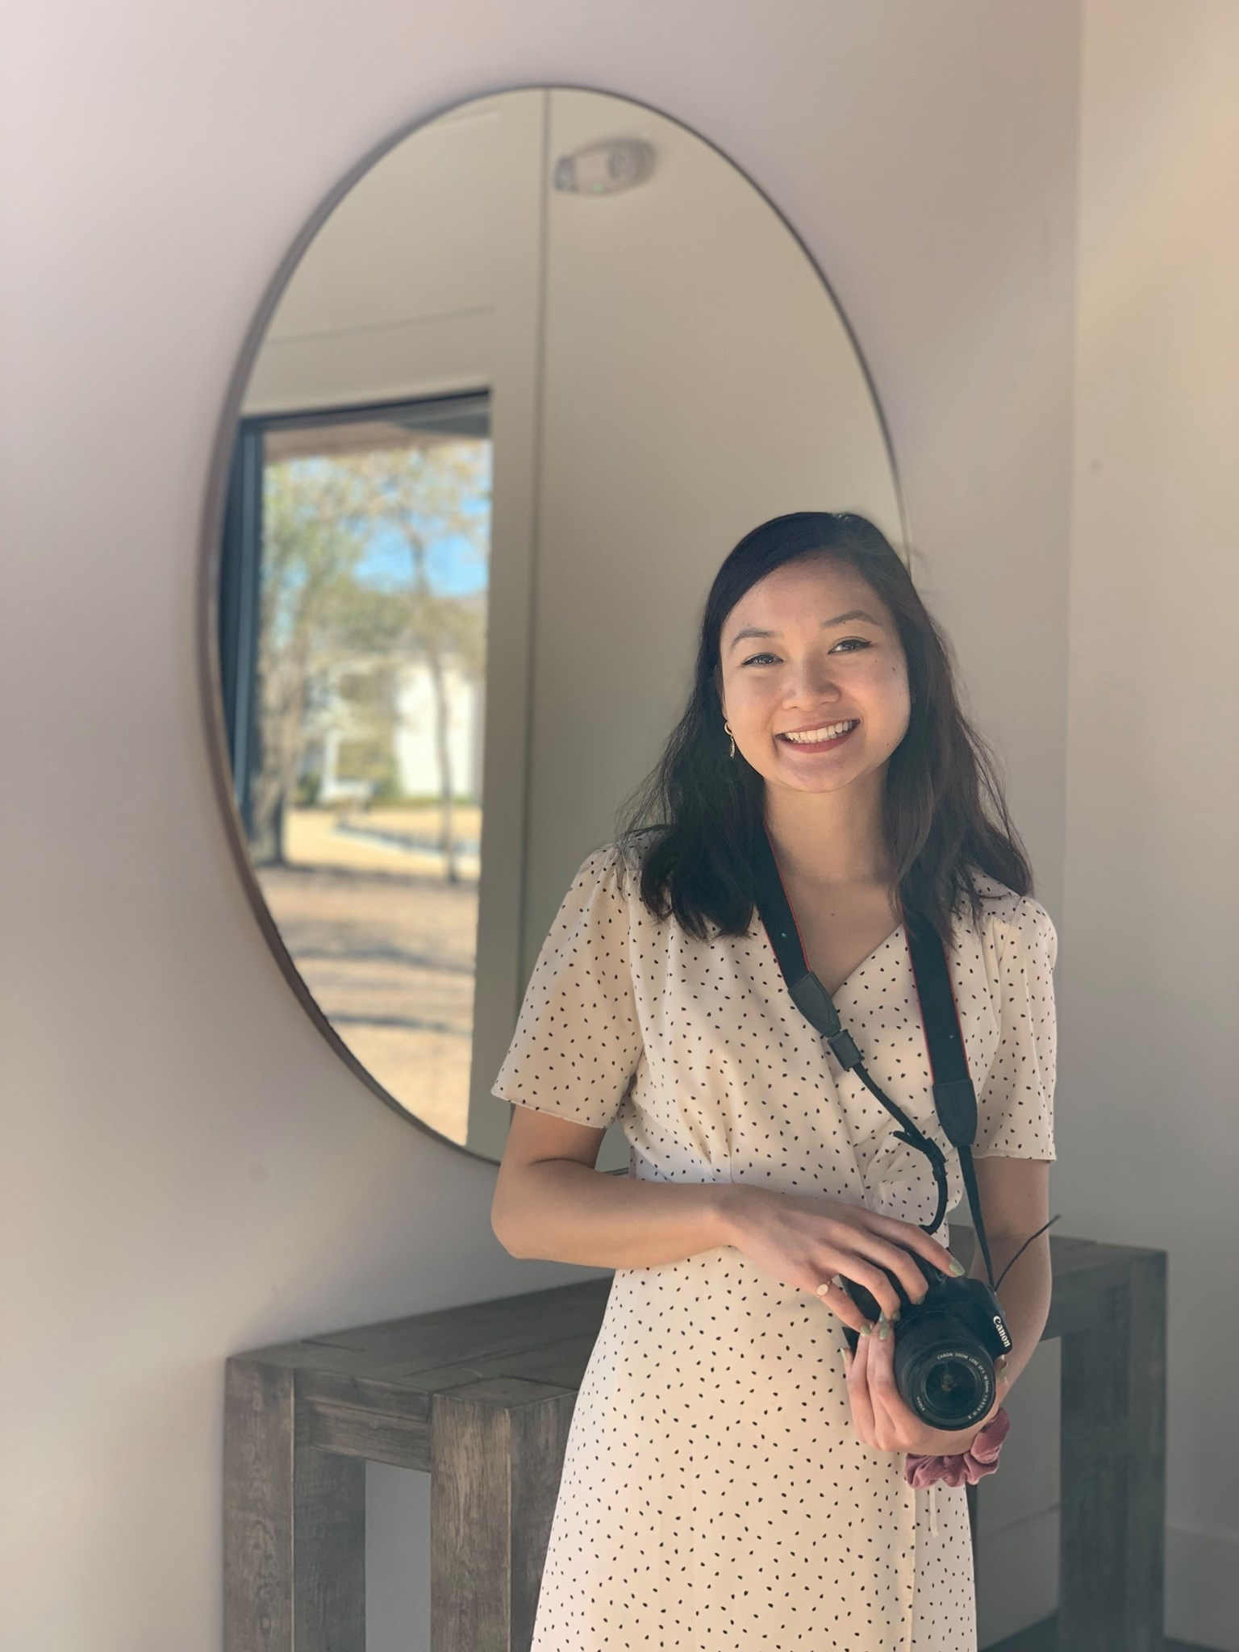
Erica Nguyen
Previous institutions: Brown University, Broad Institute
Grad Group: CAMB
Hometown: Dallas, TX and Boston, MA
Fun fact: I'm the oldest of eight siblings

Slide 18
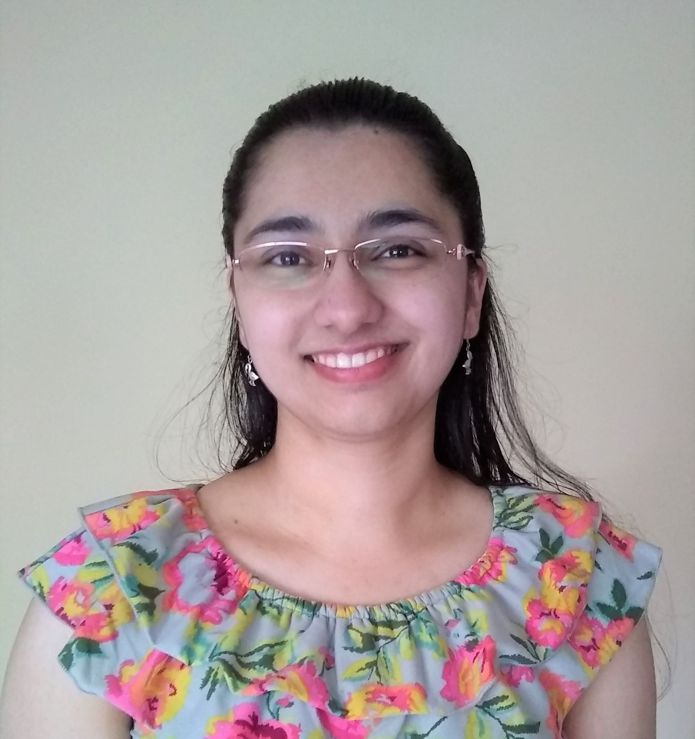
Shreya Parchure
Previous institutions: University of Pennsylvania
Grad Group: Bioengineering
Hometown: Wynnewood, PA via Pune, India via Fremont, CA
Fun fact: I love to paint and swim! Recently, I learned to crochet and have been doing many henna designs.

Slide 19
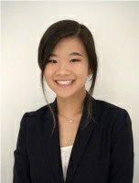
Kristen Park
Previous institutions: Johns Hopkins
Grad Group: Neuroscience
Hometown: San Jose, CA
Fun fact: I really (like really) love pasta and spent a good chunk of quarantine trying out different pasta recipes.

Slide 20
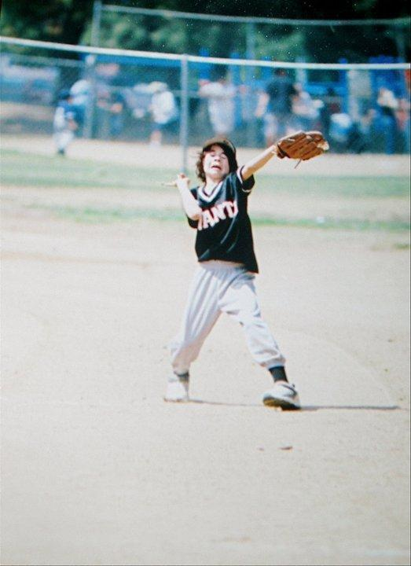
Cooper Penner
Previous institutions: Brown University, ecole Normale De superieure, Cedars Sinai Medical Center
Grad Group: NGG
Hometown: Los Angeles
Fun fact: I caught it!

Slide 21
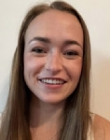
Raegan Petch
Previous institutions: Colorado State University
Grad Group: CAMB - MVP
Hometown: Elbert, CO
Fun fact: One of my hobbies is playing disc golf, and I've played at several Colorado ski areas during the summer.

Slide 22
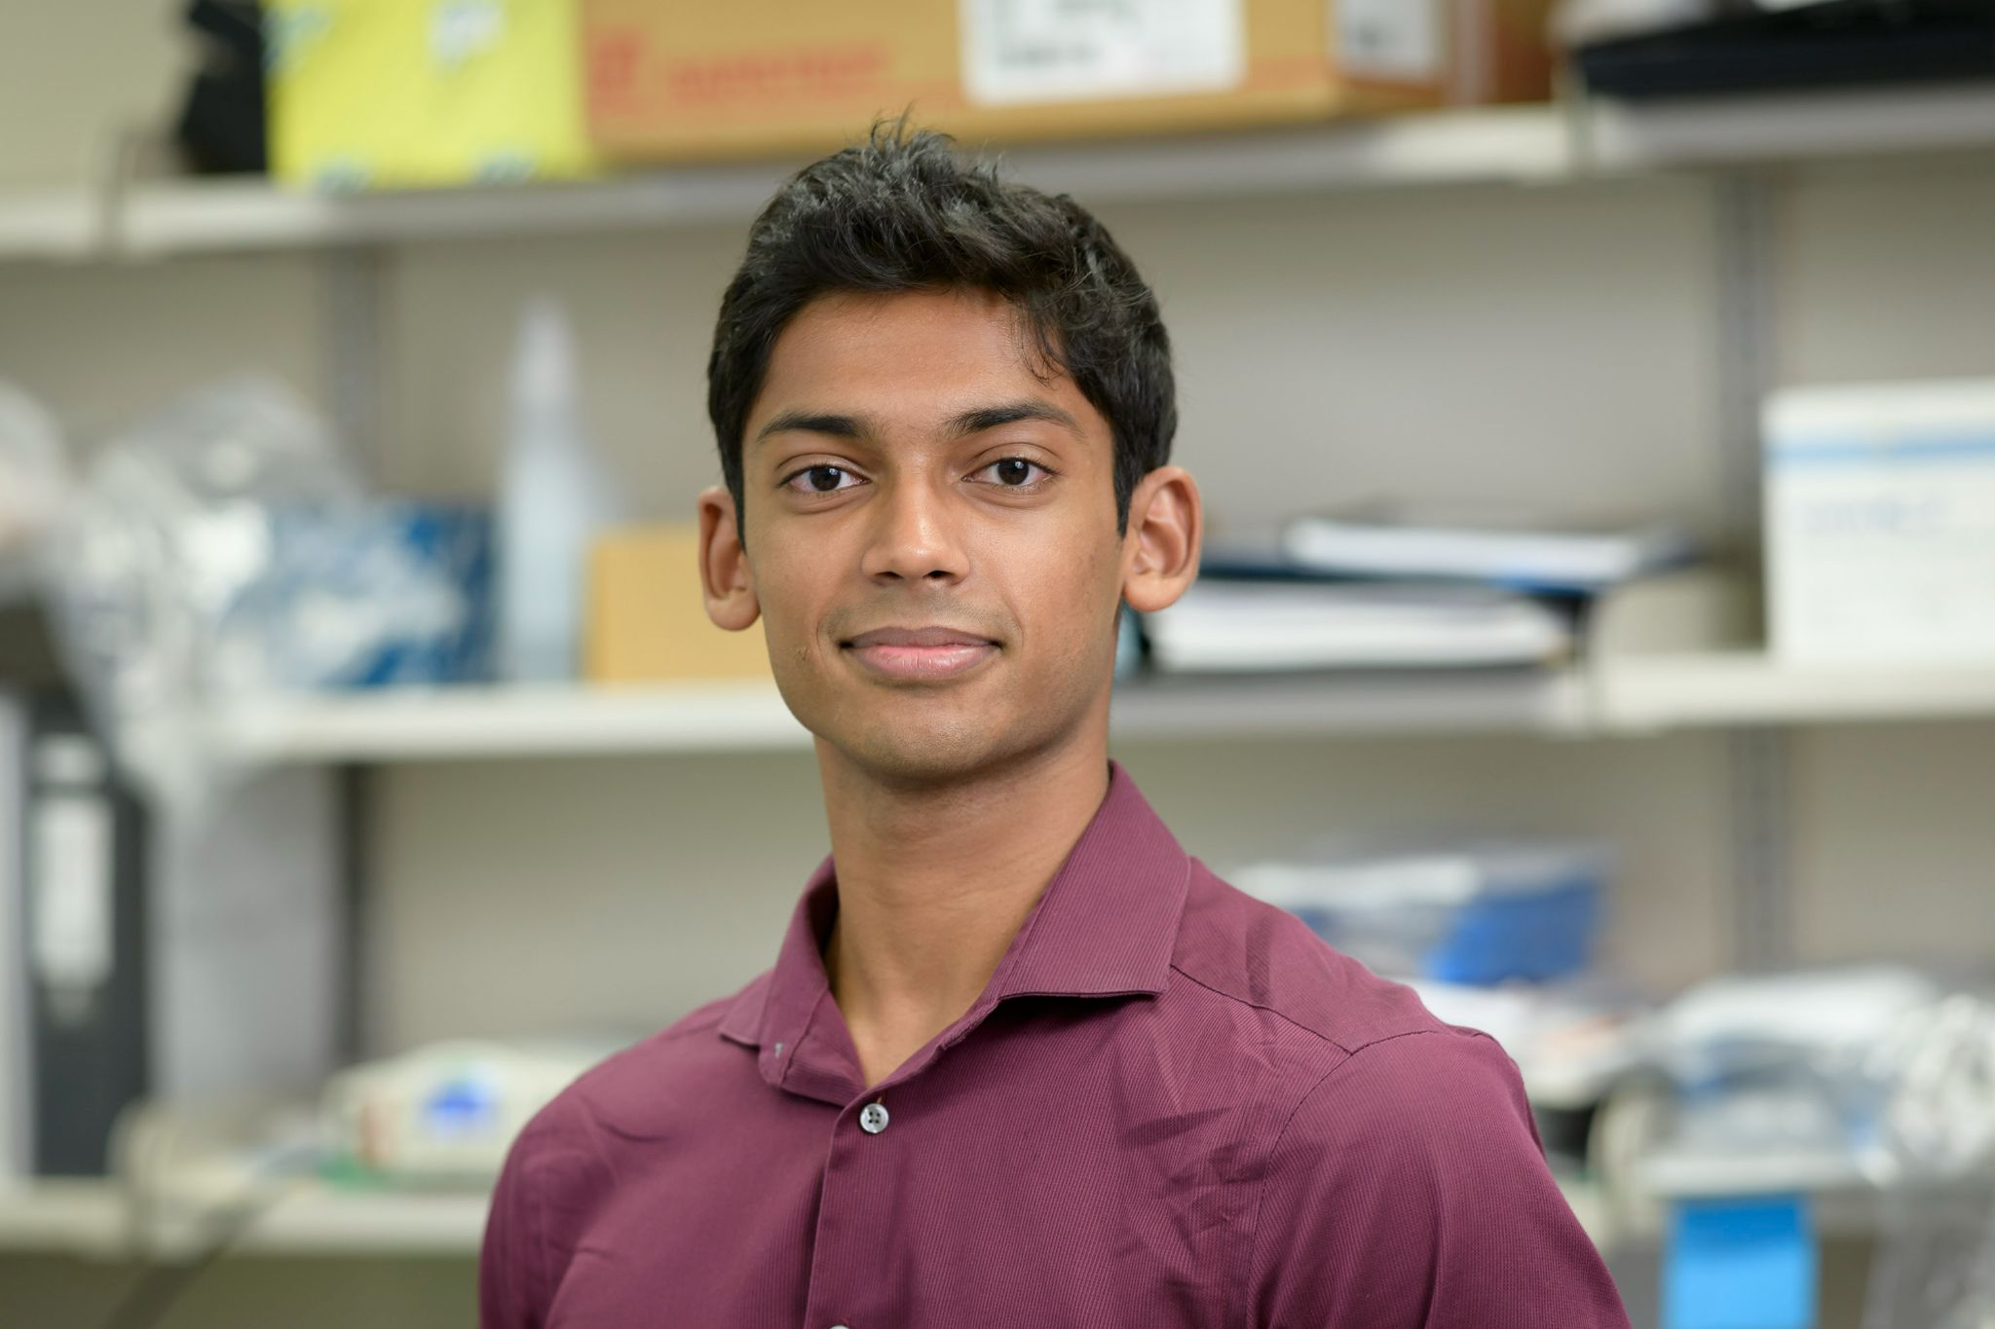
Pav Ravindran
Previous institutions: Princeton University
Grad Group: CAMB
Hometown: Westbury, NY
Fun fact: Even though I have a second degree black belt in taekwondo, I managed to lose a match by punching myself in the face.

Slide 23
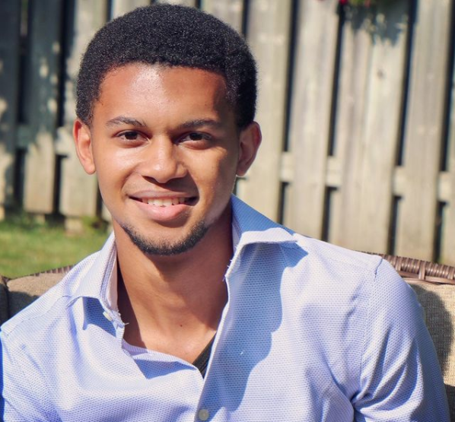
Kal Shaw
Previous institutions: Princeton University
Grad Group: Bioengineering
Hometown: Greater Toronto Area (Ontario)
Fun fact: I live for the Fresh Prince of Bel-Air

Slide 24
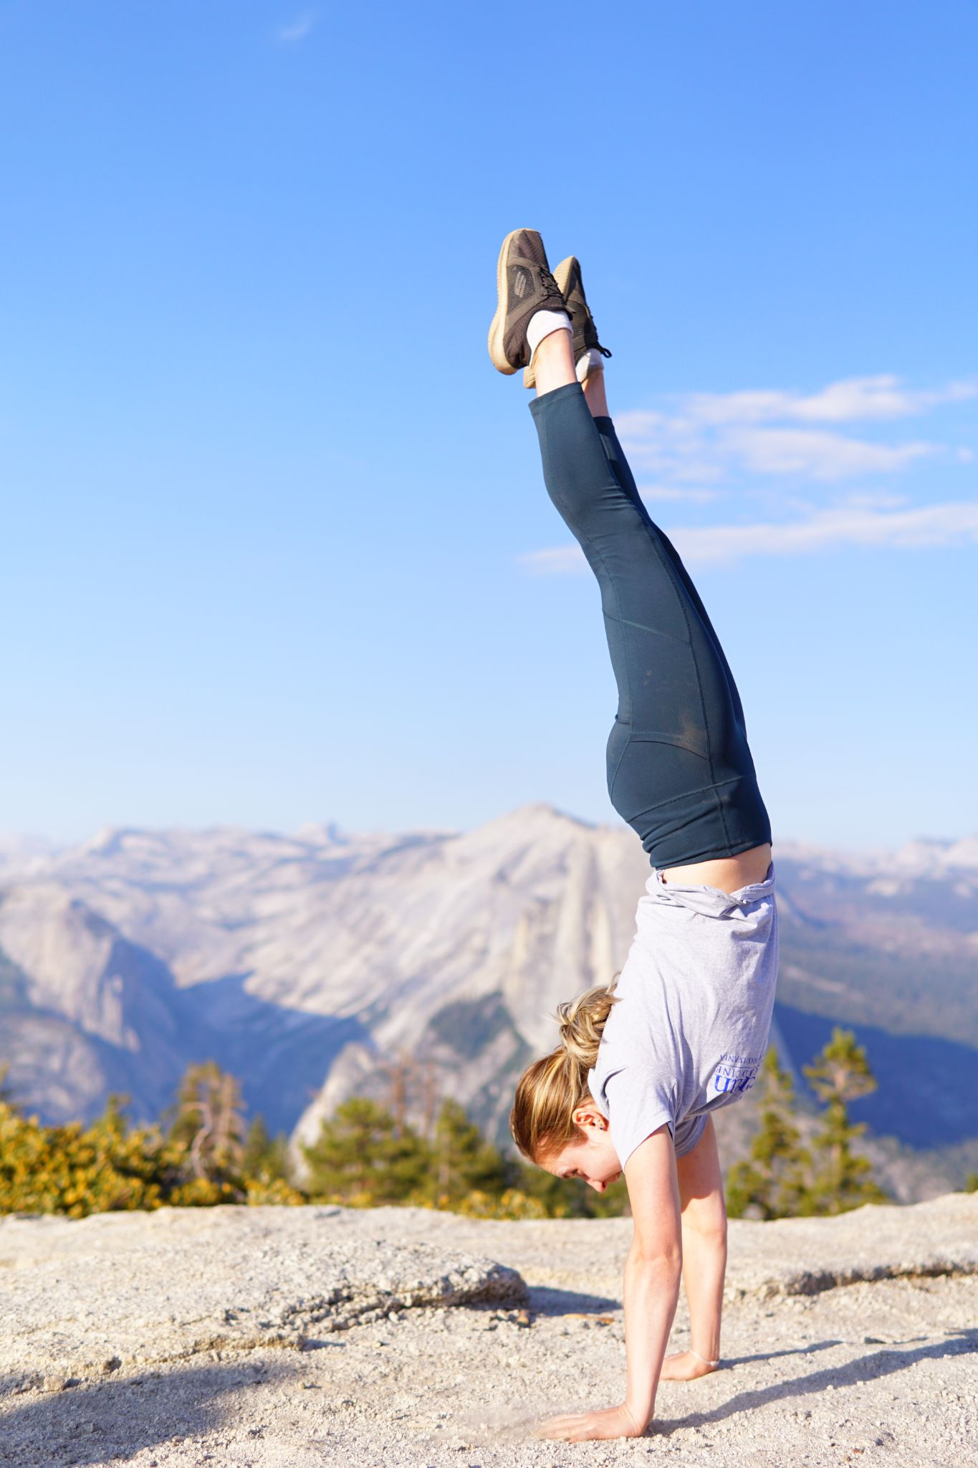
Maryia Svirydava
Previous institutions: University of Maryland, College Park, NHLBI at NIH
Grad Group: IGG
Hometown: Originally Minsk, Belarus. These days, Rockville MD.
Fun fact: I once ordered all 14 flavors at an ice cream shop and ate them at once with minimal help.

Slide 25
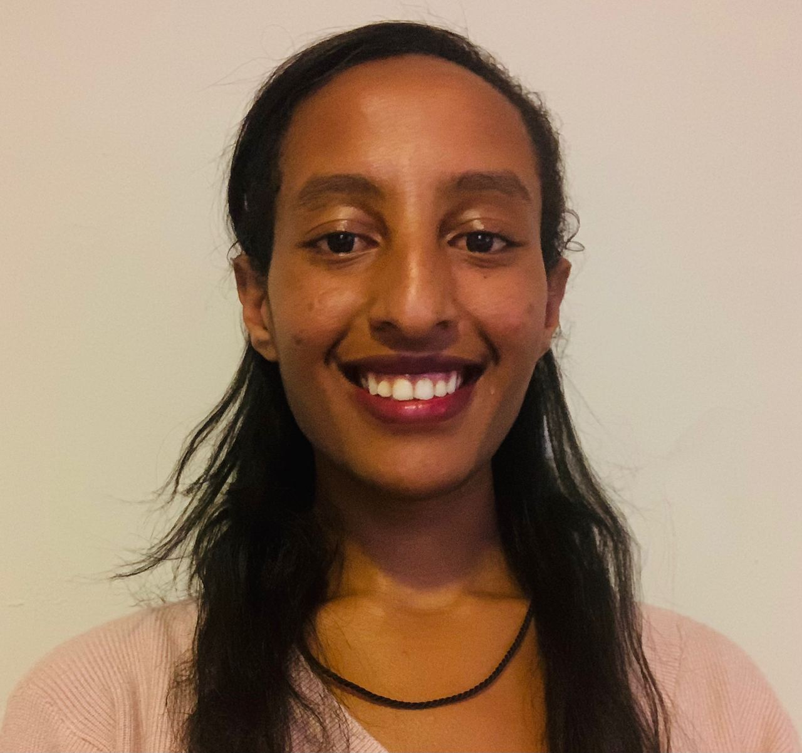
Saba Tegegne
Previous institutions: University of Toronto, Yale University
Grad Group: IGG
Hometown: Addis Ababa, Ethiopia

Slide 26
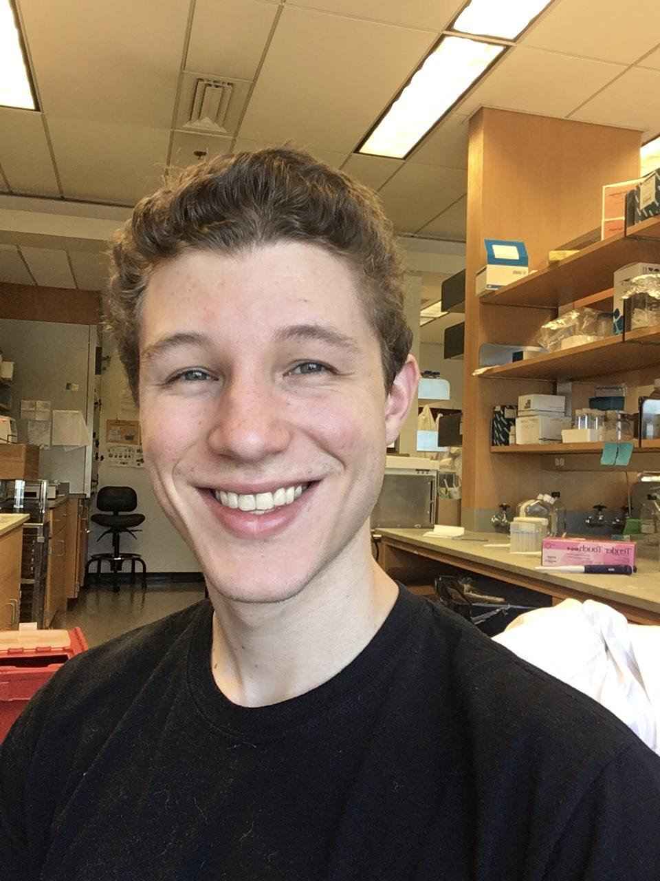
HenrY Utset
Previous institutions: Vanderbilt University
Grad Group: IGG
Hometown: Chicago, IL
Fun fact: has a four-year Duolingo streak

Slide 27
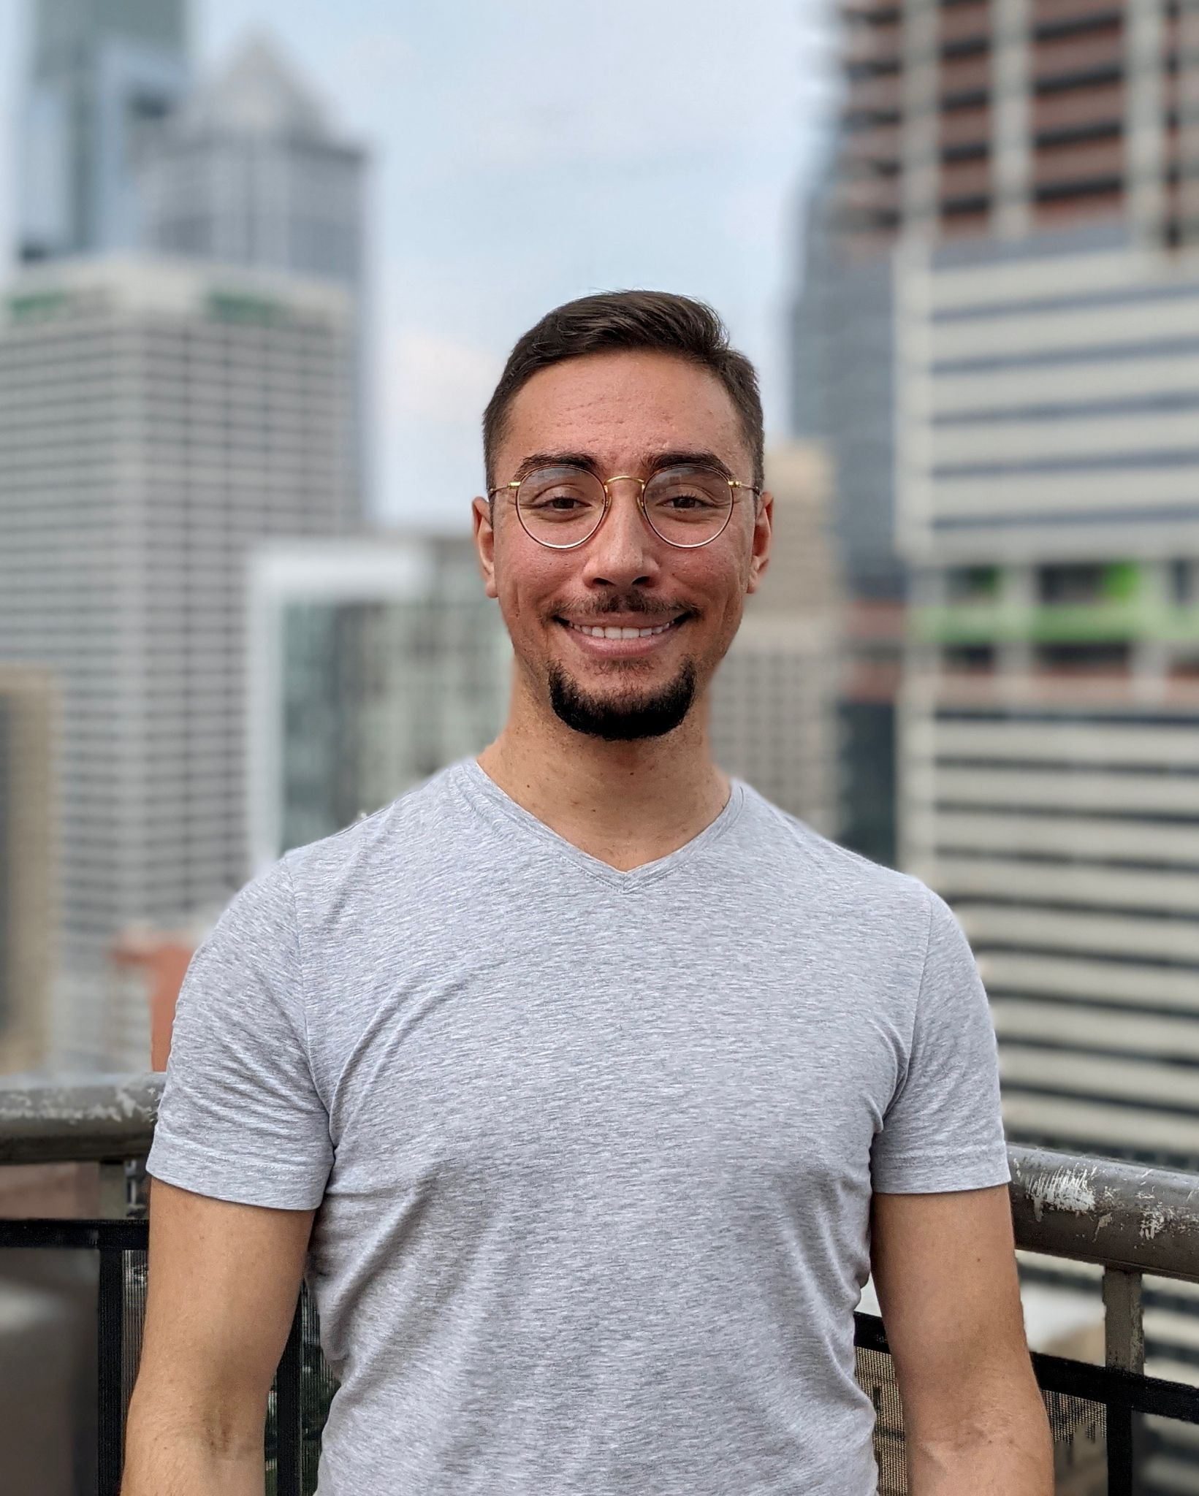
Colin Villarin
Previous institutions: University of Vermont, MGH
Grad Group: Neuroscience Grad Group
Hometown: Wynnewood, PA (outside of philly)
Fun fact: I competed nationally in both pistol shooting and ballroom & latin dancing during college.

Slide 28
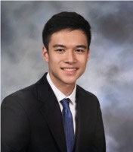
Chris Wu
Previous institutions: Stanford University
Grad Group: Bioengineering
Hometown: Chapel Hill, NC
Fun fact: I had a conversation with Elon Musk about eco-friendly rocket fuel

Slide 29
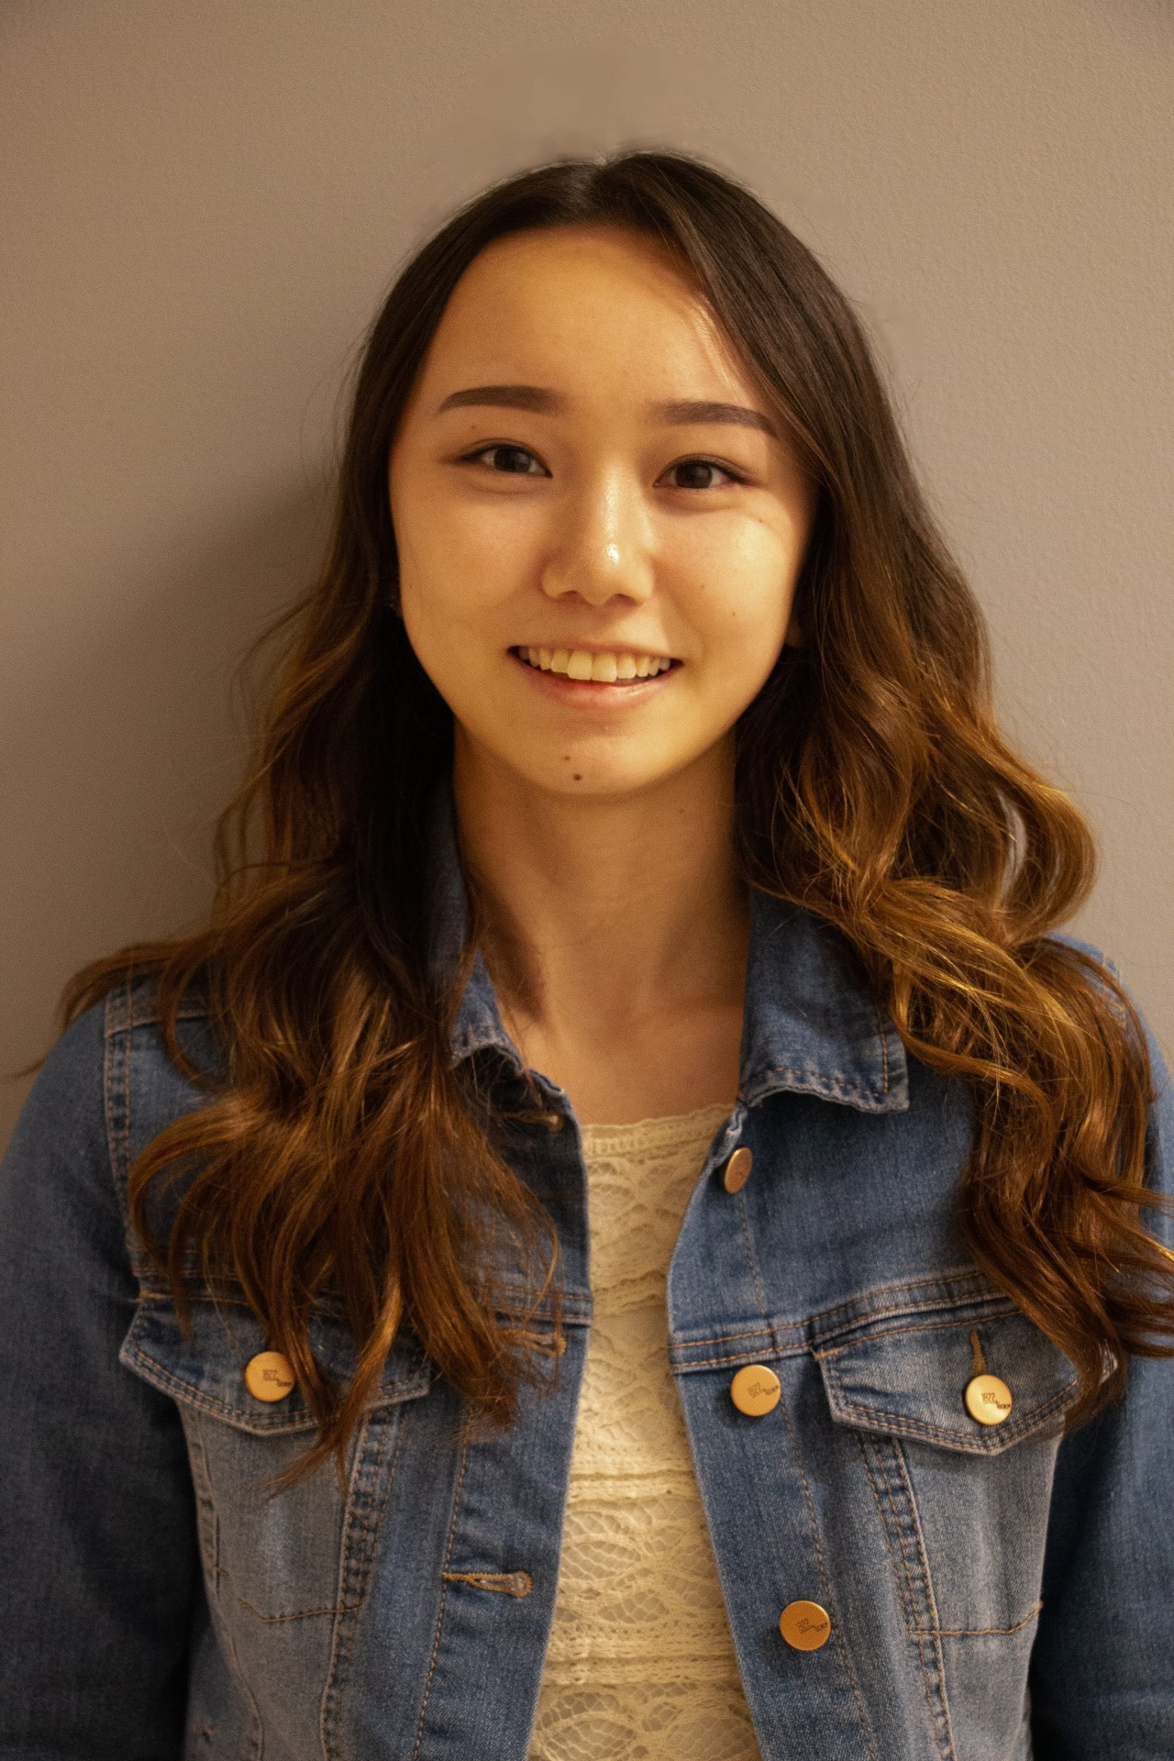
Kat Xia
Previous institutions: Santa Clara University
Grad Group: CAMB
Hometown: Mountain View, California
Fun fact: My high school friends turned my handwriting into a computer font.

Slide 30
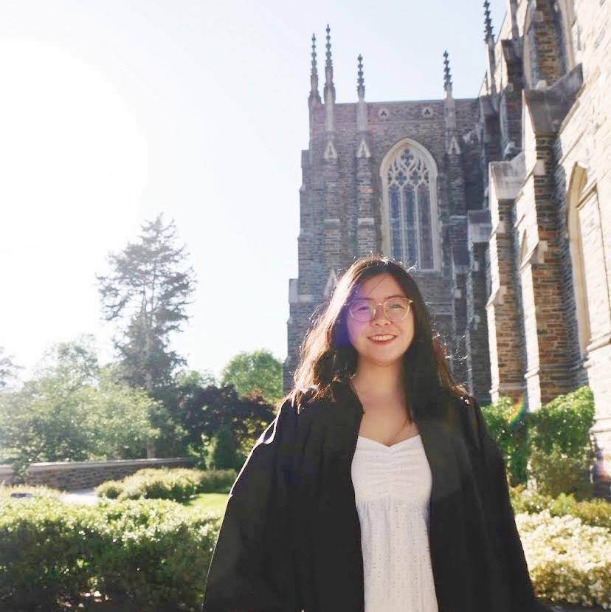
Barbara Xiong
Previous institutions: Duke
Grad Group: GCB
Hometown: Nashville, TN
Fun fact: I enjoy graphic design and connecting it to research/STEM—I’ve designed a cover for an issue of a physical chemistry journal, been commissioned to animate figures for illustrating new statistical methods, and volunteered with the UN to produce educational animated videos for COVID awareness.

Slide 31
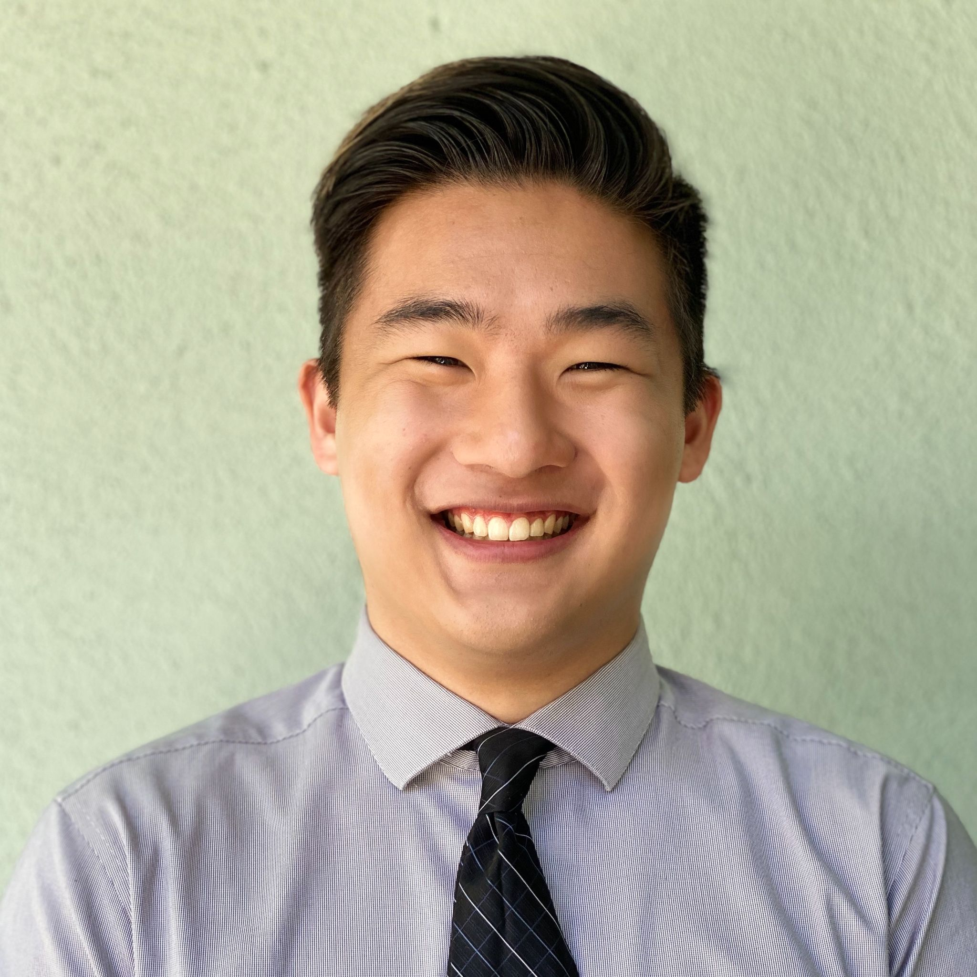
Michael Yao
Previous institutions: Caltech
Grad Group: Bioengineering
Hometown: Pasadena, CA
Fun fact: I used to swim DIII during college before I picked up ballroom dancing!

Slide 32
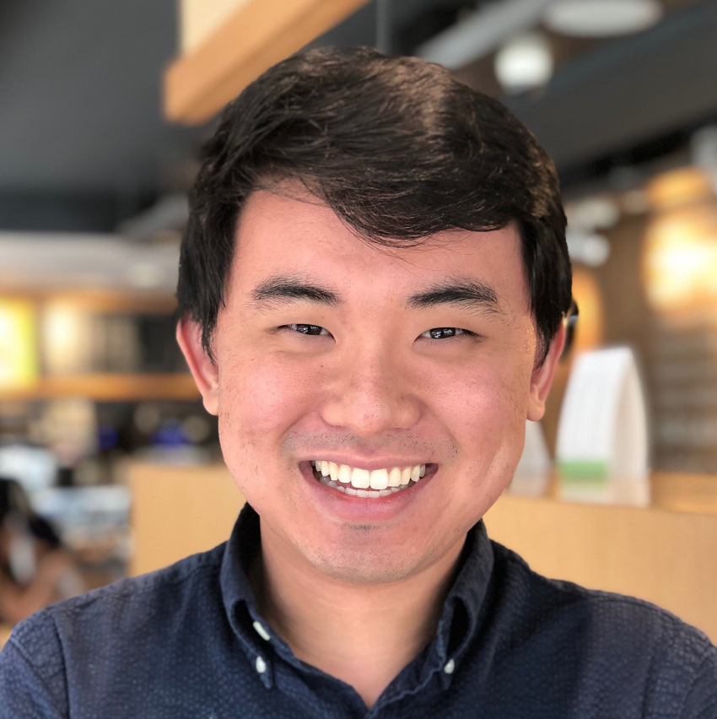
JacK You
Previous institutions: University of Pennsylvania
Grad Group: CAMB
Hometown: Pittsburgh, PA
Fun fact: I love to cook (always looking for good recipes)!

